Slide 1
Frothy Head Brewing Data Investigation

Slide 2
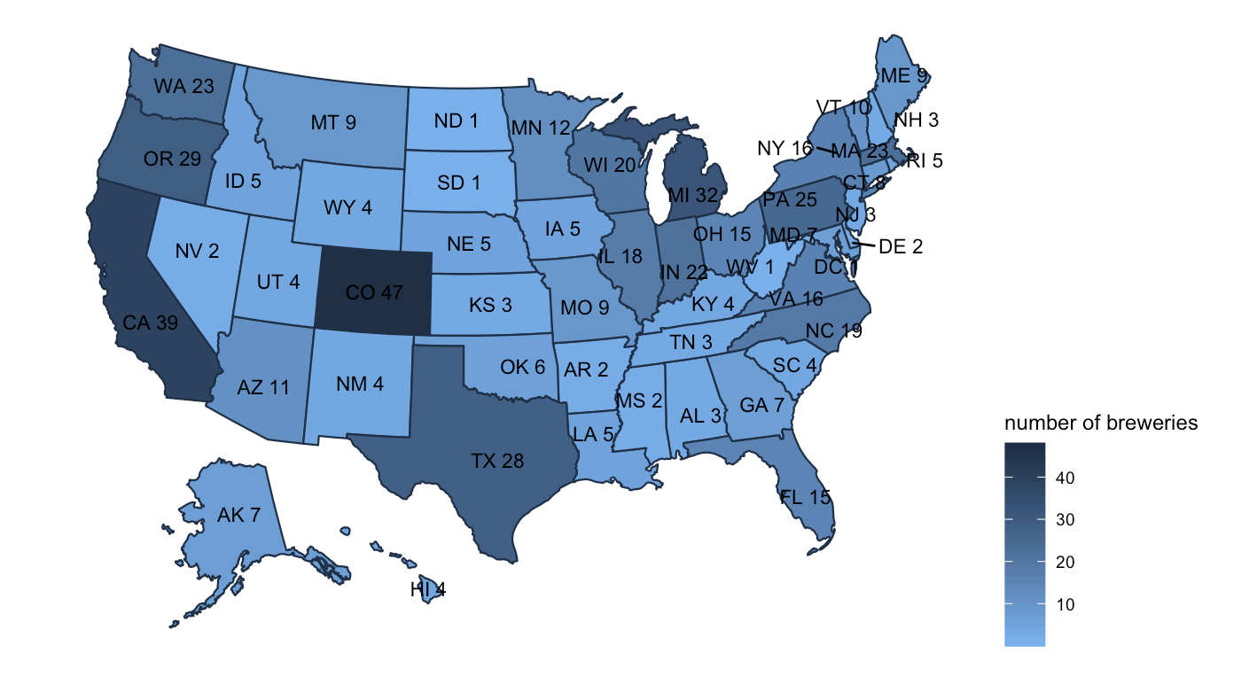
States Brewery Map

Slide 3
Tables and Data
The provided data sets along with the cleaned and merged data can be found in the accompanying files along with the tables for the following:
The number of breweries per state
Missing values per variable
Statistical summary of alcohol content
Most alcoholic Beer
Most bitter beer

Slide 4
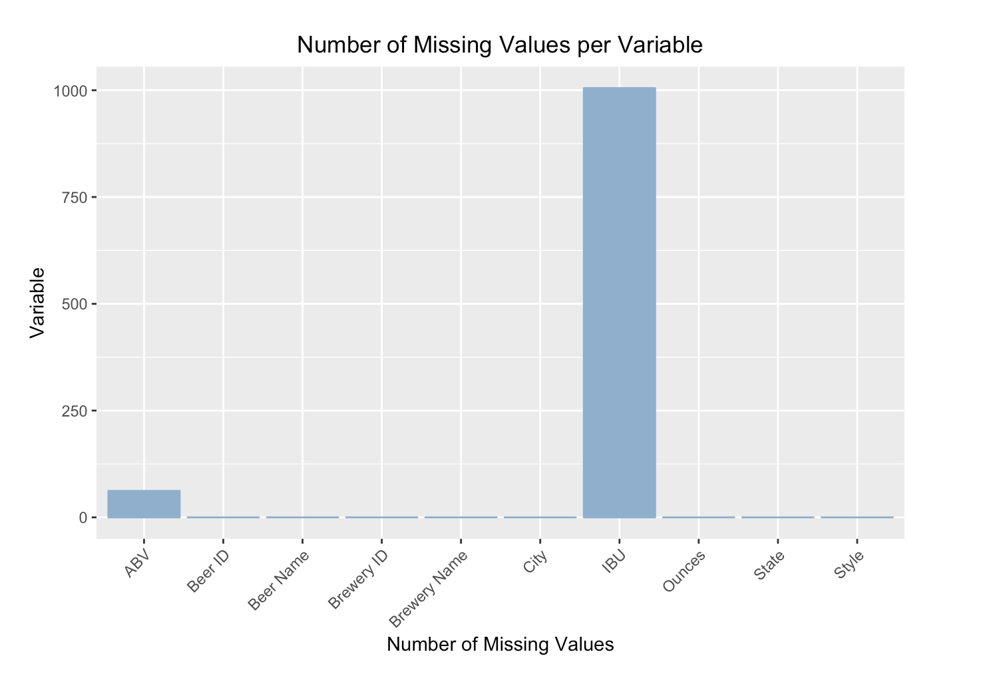
Missing Values

Slide 5
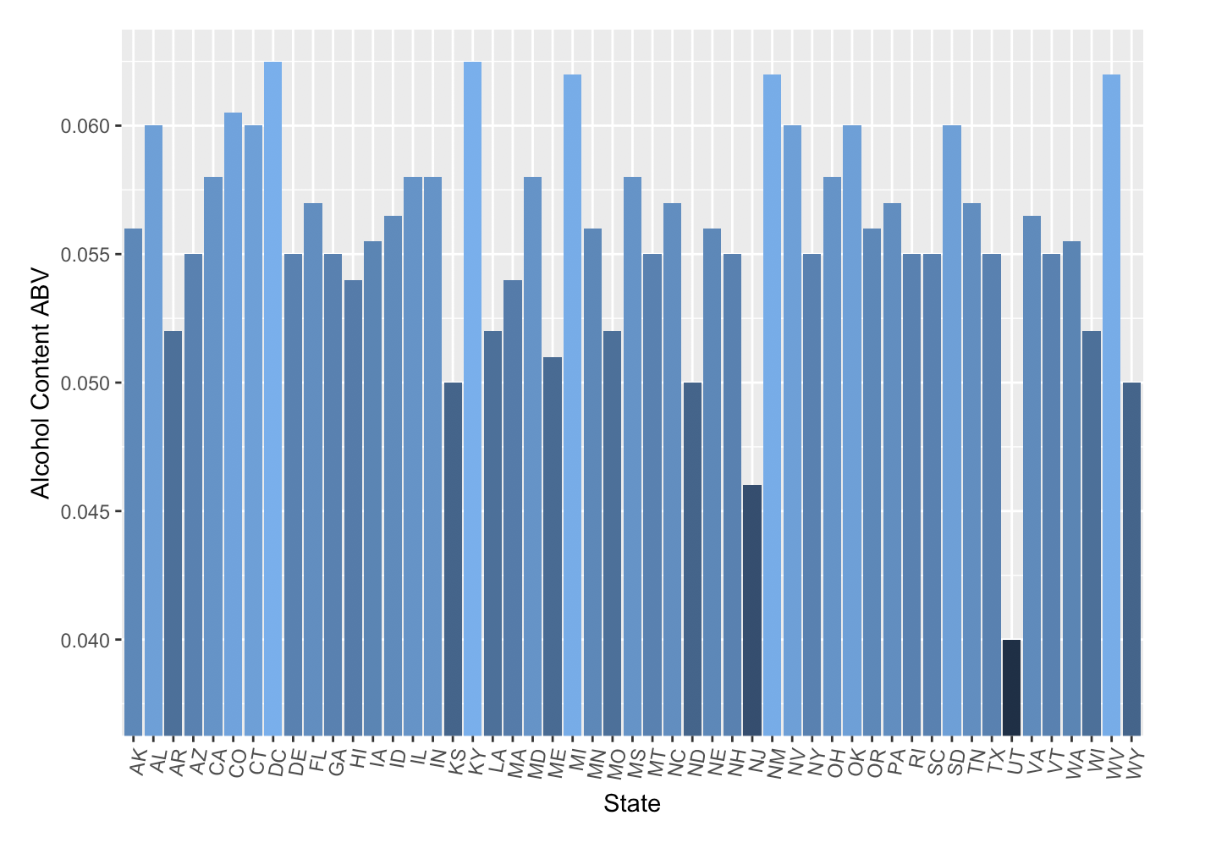
Median Alcohol Content by State

Slide 6
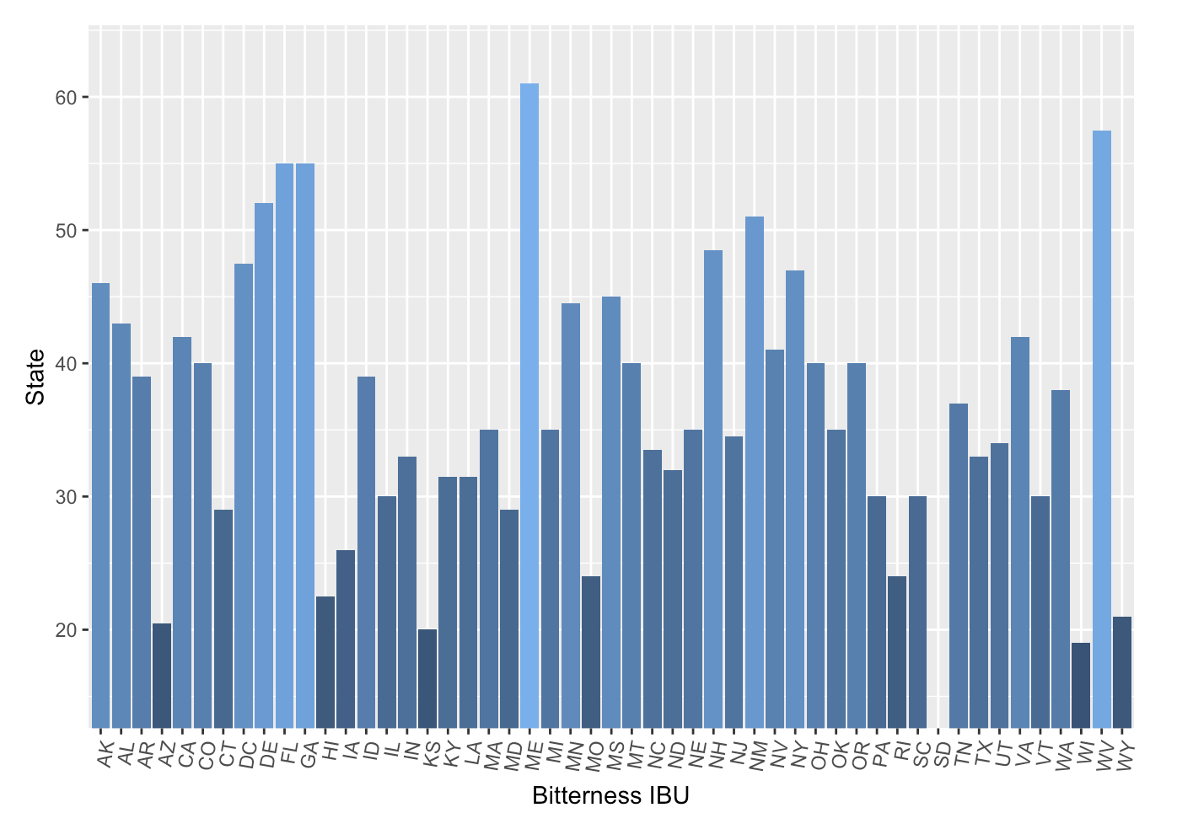
Median Bitterness IBU by State

Slide 7
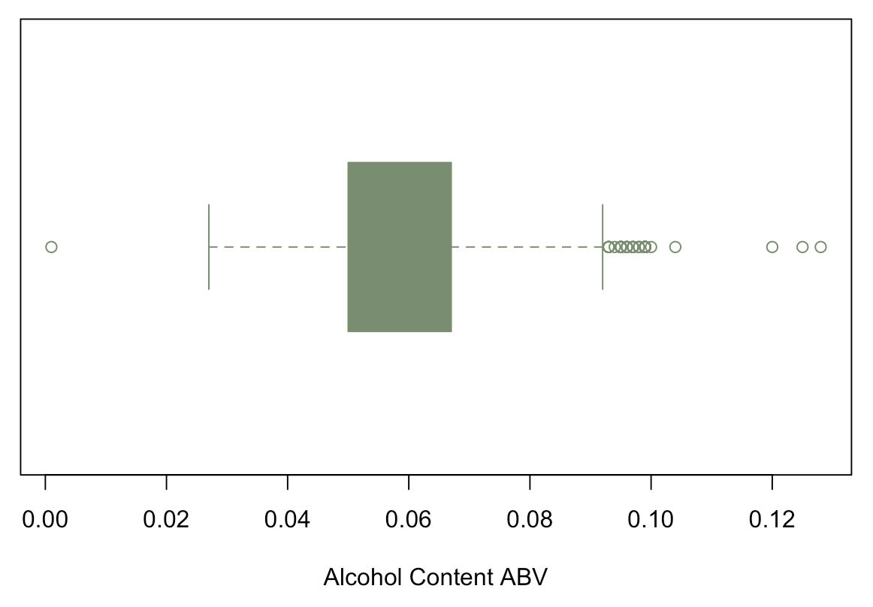
Summary of Alcohol Content ABV and The Most Alcoholic Beer
The most alcoholic beer is the Lee Hill Series Vol. 5 - Belgian Style Quadrupel Ale produced by Upslope Brewing Company in Boulder Colorado with an alcohol content of 0.128.

Slide 8
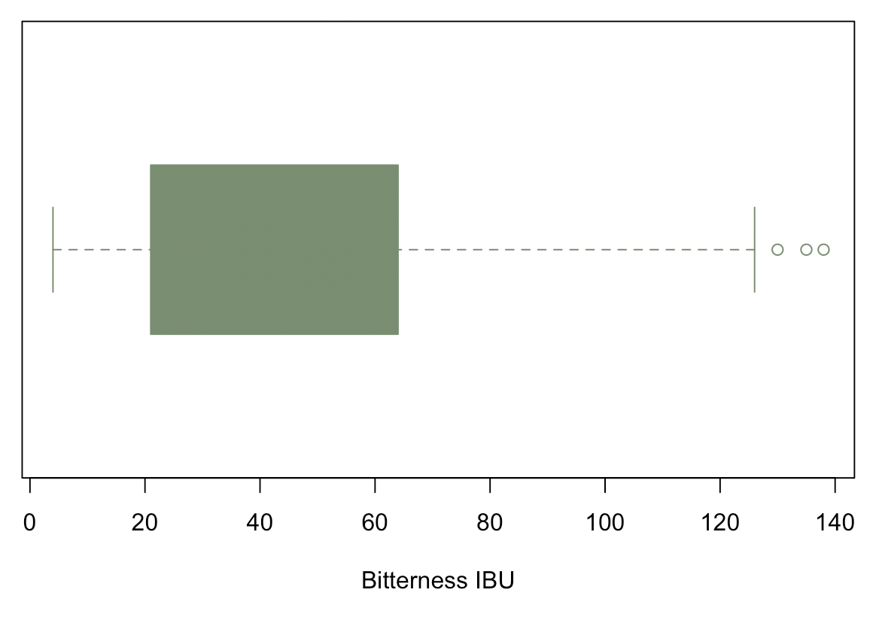
The Most Bitter Beer IBU
The most bitter beer is Bitter Bitch Imperial IPA produced by Astoria Brewing Company in Astoria Oregon with 1.38 international bitterness units.

Slide 9
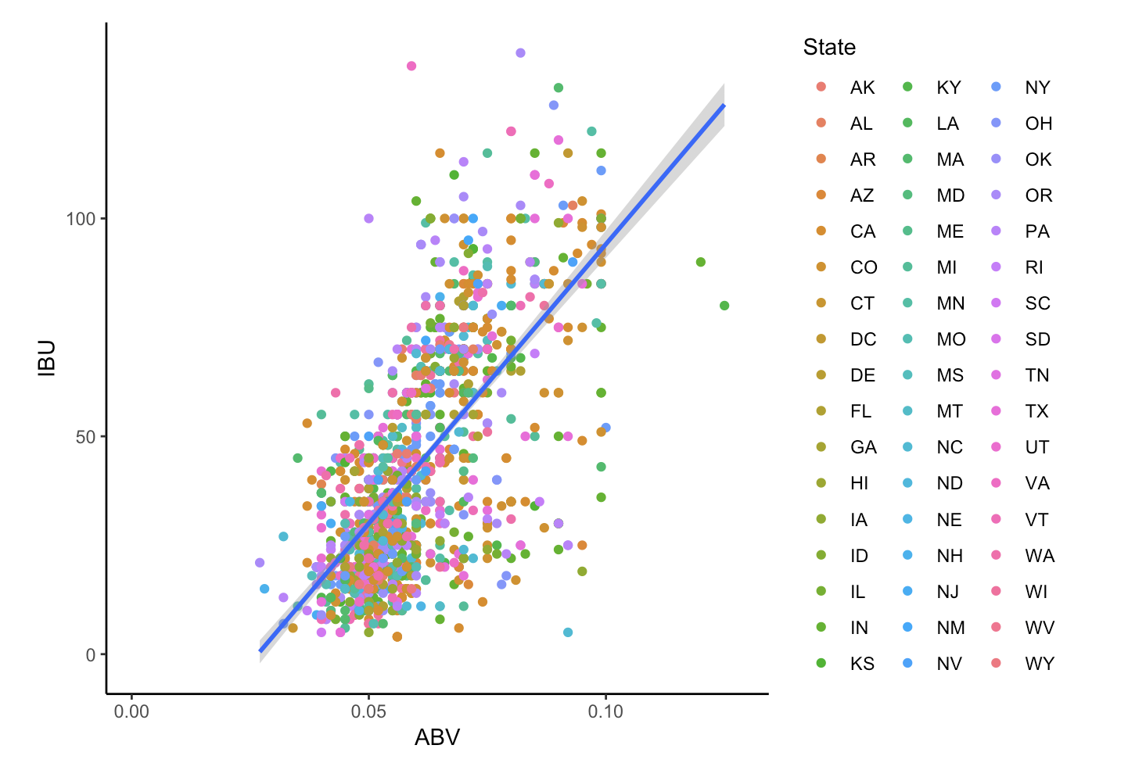
Alcohol Content ABV vs Bitterness IBU
Pearson’s R =
0.67

Slide 10
Take Away
We recommend making a beer with the following:
Alcohol content ABV between 0.05 and 0.07
Bitterness IBU between 25 and 50
In a state that has a median alcohol content and bitterness within the ranges above

Slide 11
Take Away
State of Interest: Texas
Median alcohol content of 0.055
Median bitterness of 32

